Slide 1
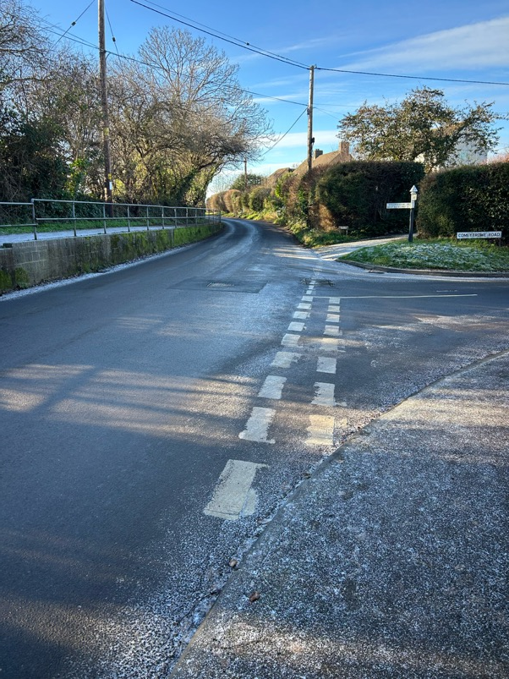
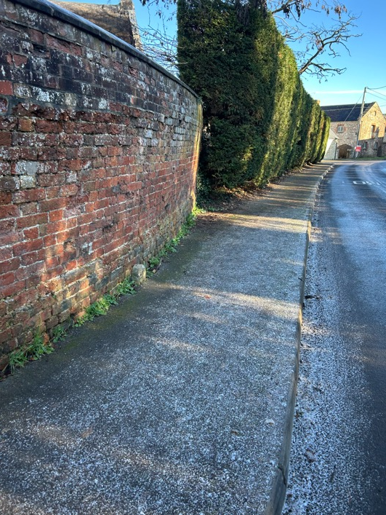
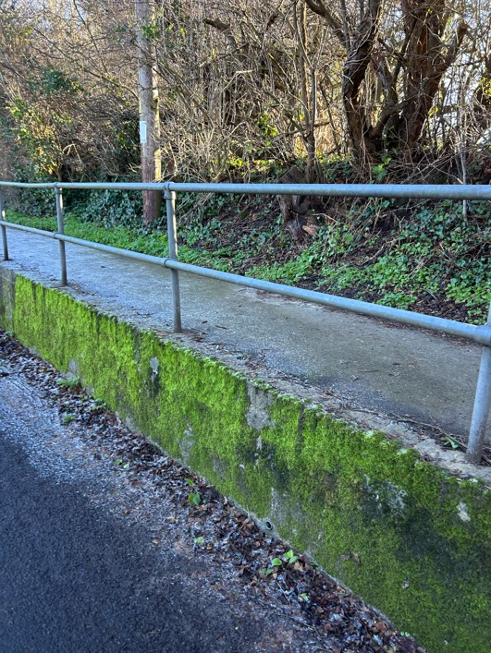
Reoccurring problem with black ice here
Location 1: In dip between wall and tree line
Location 2: To the right of the telegraph pole
Pavement is wider in both locations

